Slide 1
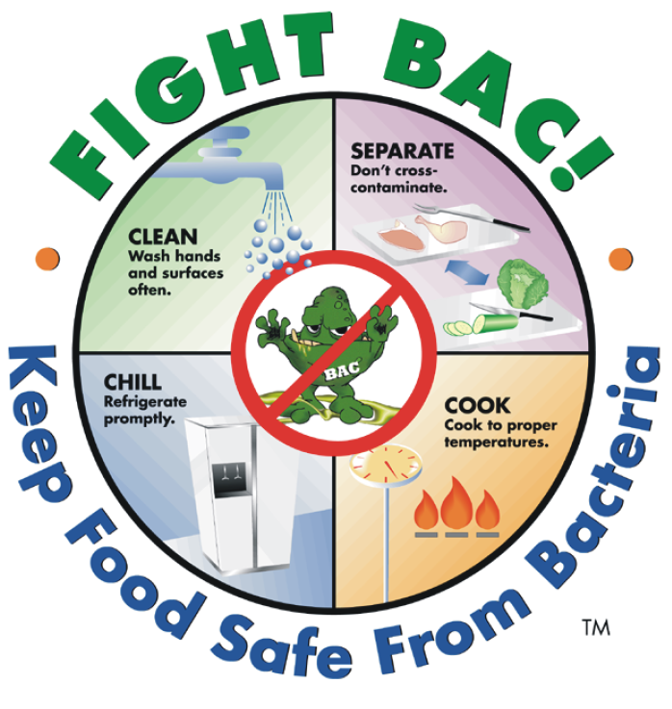
Food Safety/Food-Borne Illnesses
HFN 20/ELL
Notes:
Teacher’s Notes: Try to enunciate as much as possible for ELLs. Read slowly and check often for understanding. If required, pause lesson for mini-explanations, examples, and/or clarification.

Slide 2




Introduction to Food-Borne Illnesses:
What is a FOOD-BORNE ILLNESS?
CLASS DISCUSSION…….

Slide 3
*Word Wall *
In next slides, if you see a word that is underlined add it to your word wall sheet

Slide 4
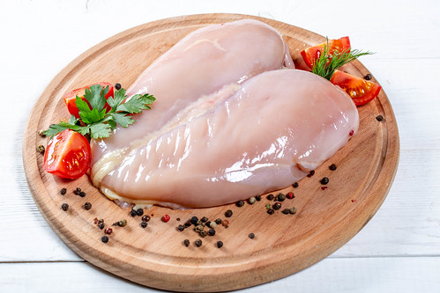
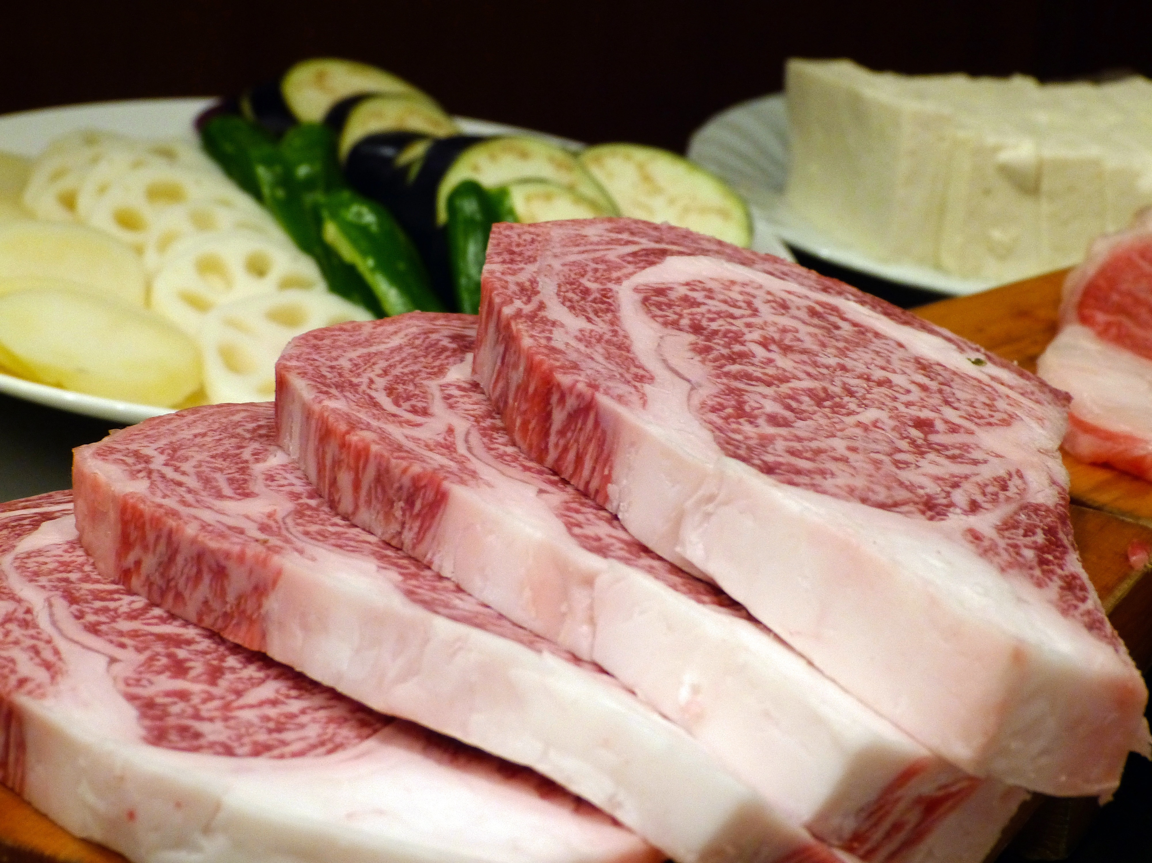
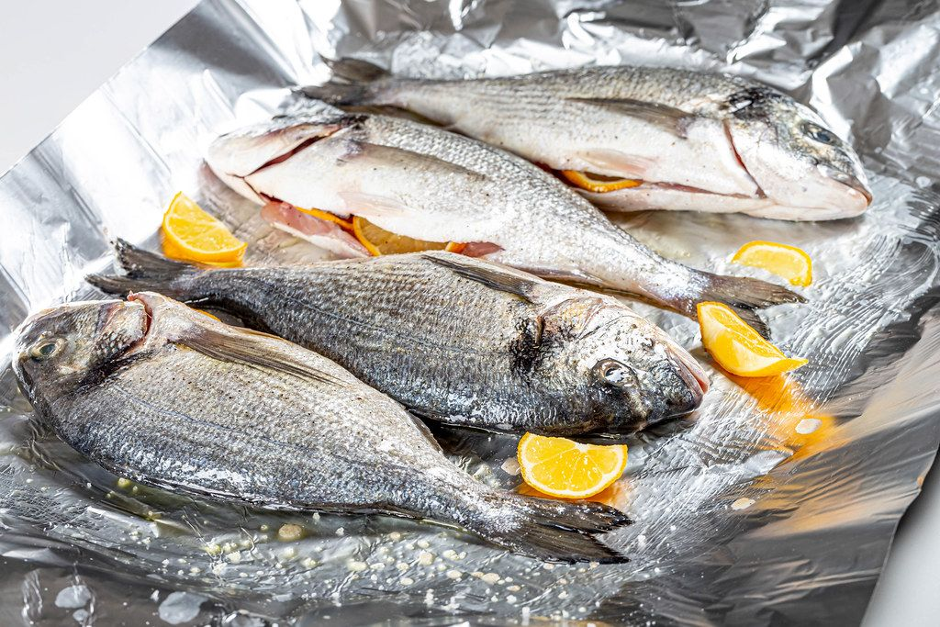

Food Borne-Illness
A food-borne illness is caused by different bacteria.
Some bacteria are in the food you eat, usually from
cross-contamination or from undercooked food. The bacteria enter
your body when you eat the food they are in.

Slide 5


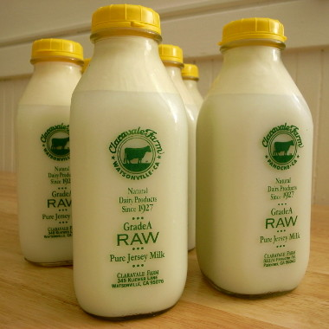
TYPES OF FOOD-BORNE-ILLNESSES
Campylobacter (cam·py·lo·bac·ter)
Symptoms include stomach cramps and severe diarrhea
but rarely vomiting. They can begin 2-10 days after eating
contaminated food but usually within 2-5 days. Main sources are
undercooked chicken and other meats, handling pets, raw milk and
contaminated water. This organism is the most common cause of acute diarrhea in adults.

Slide 6
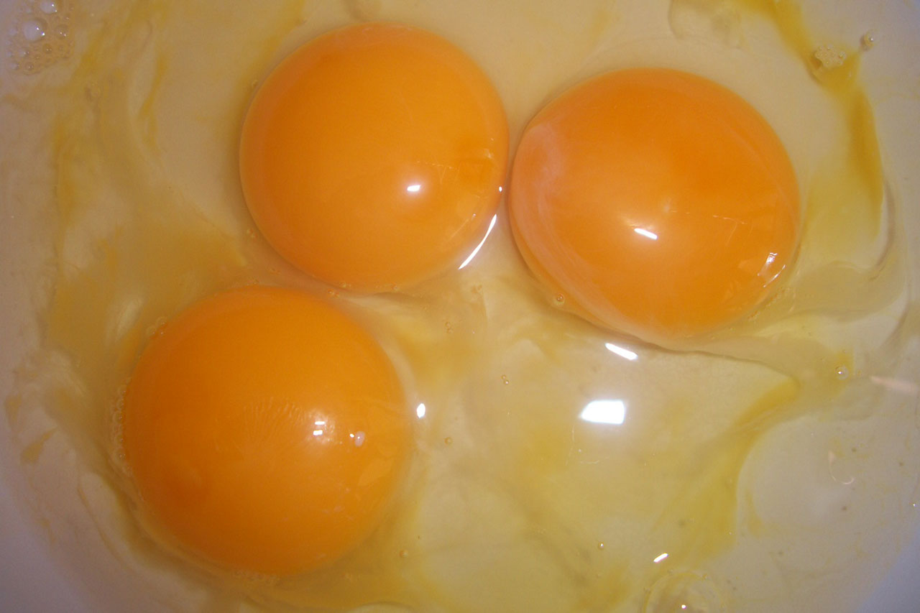
TYPES OF FOOD-BORNE-ILLNESSES
Salmonella (sal·mo·nel·la)
Symptoms include stomach pain, fever, diarrhea and vomiting.
It usually takes about 12-48 hours for the illness to develop. Symptoms
can be much more severe in the young and elderly. Main sources are undercooked meat and poultry, untreated milk and raw or undercooked
eggs. This organism is the second most common form of food poisoning.

Slide 7
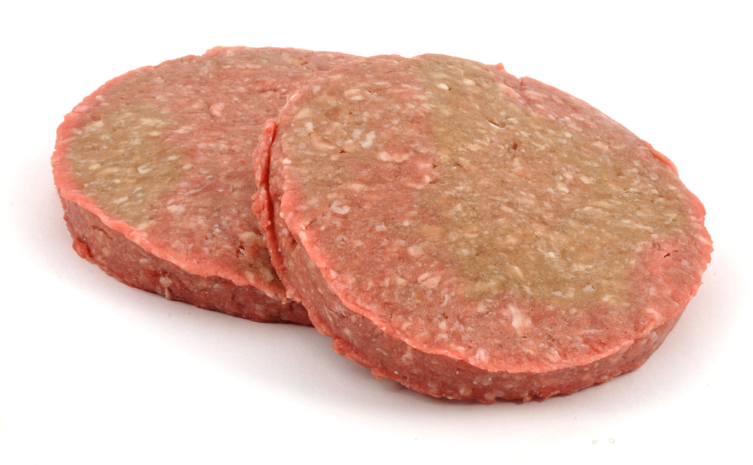
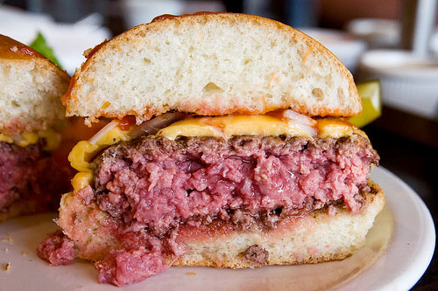
TYPES OF FOOD-BORNE-ILLNESSES
E.Coli (E. co·li)
Symptoms include severe bloody diarrhea, and the infection can
lead to serious kidney damage in children. Main sources are
undercooked beef burgers and minced beef, contaminated cooked
meats and unpasteurized milk.

Slide 8
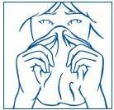
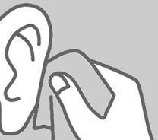
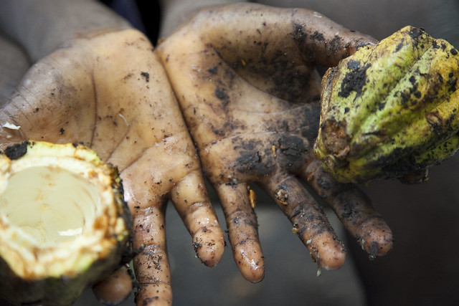
TYPES OF FOOD-BORNE-ILLNESSES
Staphylococcus (staph·y·lo·coc·cus)
Symptoms include stomach pains and vomiting, 1-6 hours
after eating and it usually takes 12-24 hours for symptoms to subside.
This bacterium is found on humans (particularly in the nose, throat,
skin and ears) and is transferred to food through poor hygiene
practices.

Slide 9
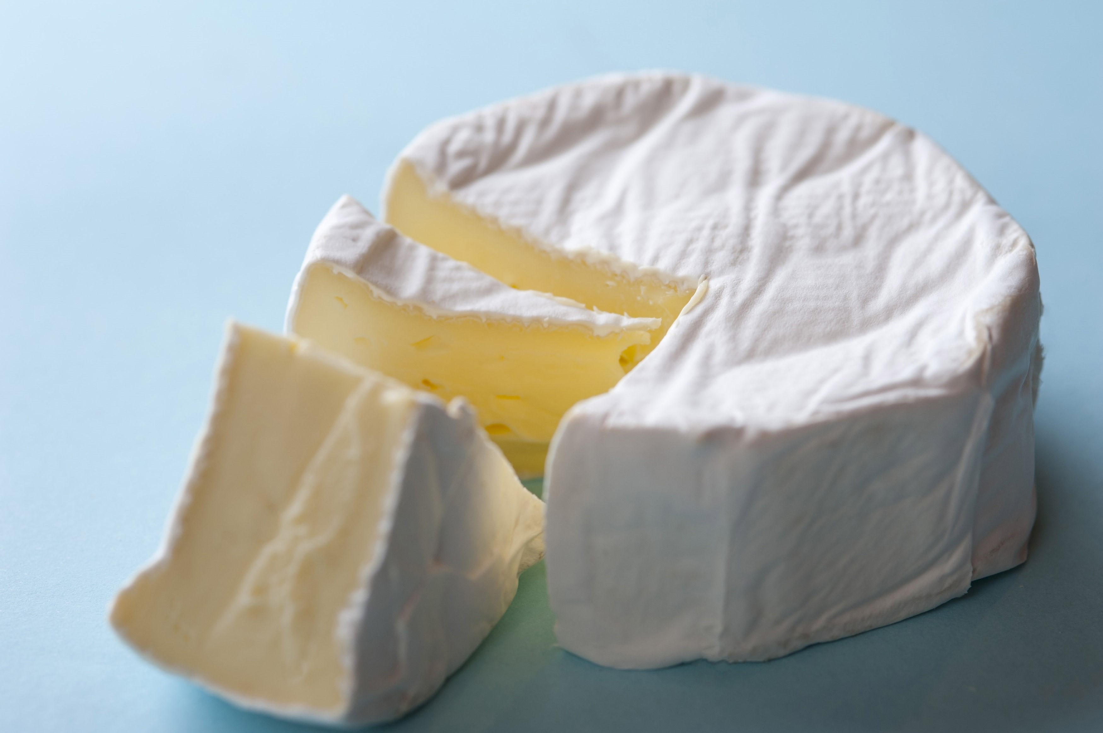
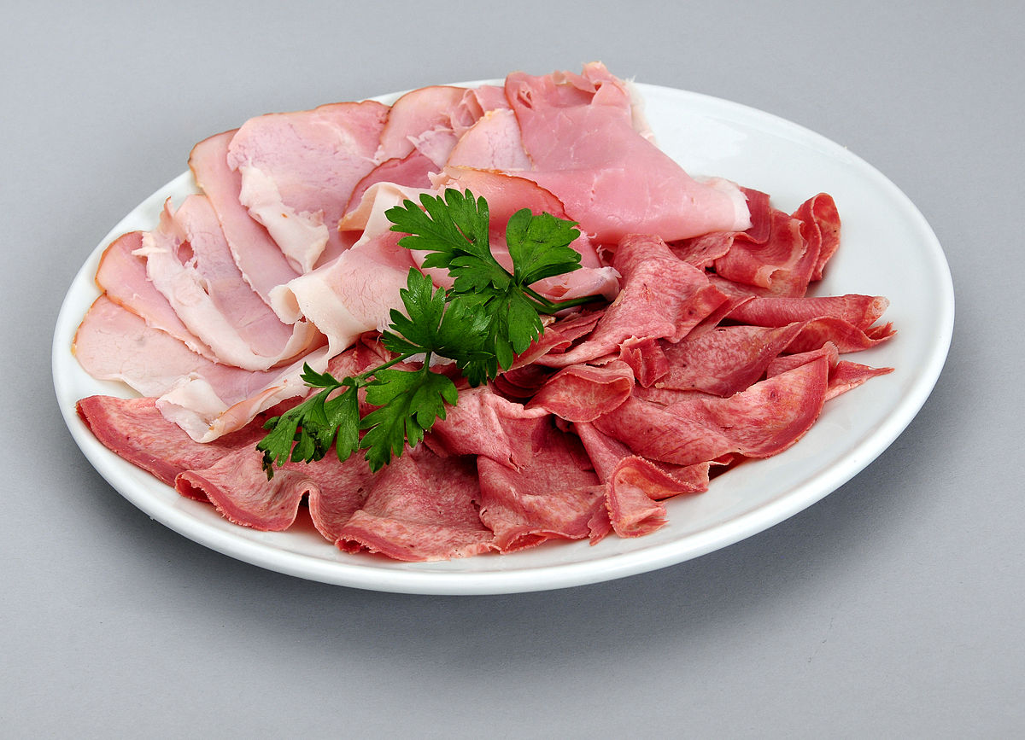
TYPES OF FOOD-BORNE-ILLNESSES
Listeria (lis·te·ri·a)
Mild flu-like illness in healthy people but can cause much
more severe illnesses in the young and elderly. Sources include
soft cheeses (such as Brie) and deli meats. Prevention of food
poisoning from Listeria is more difficult than other organisms as it
can still multiply at refrigerator temperatures.

Slide 10
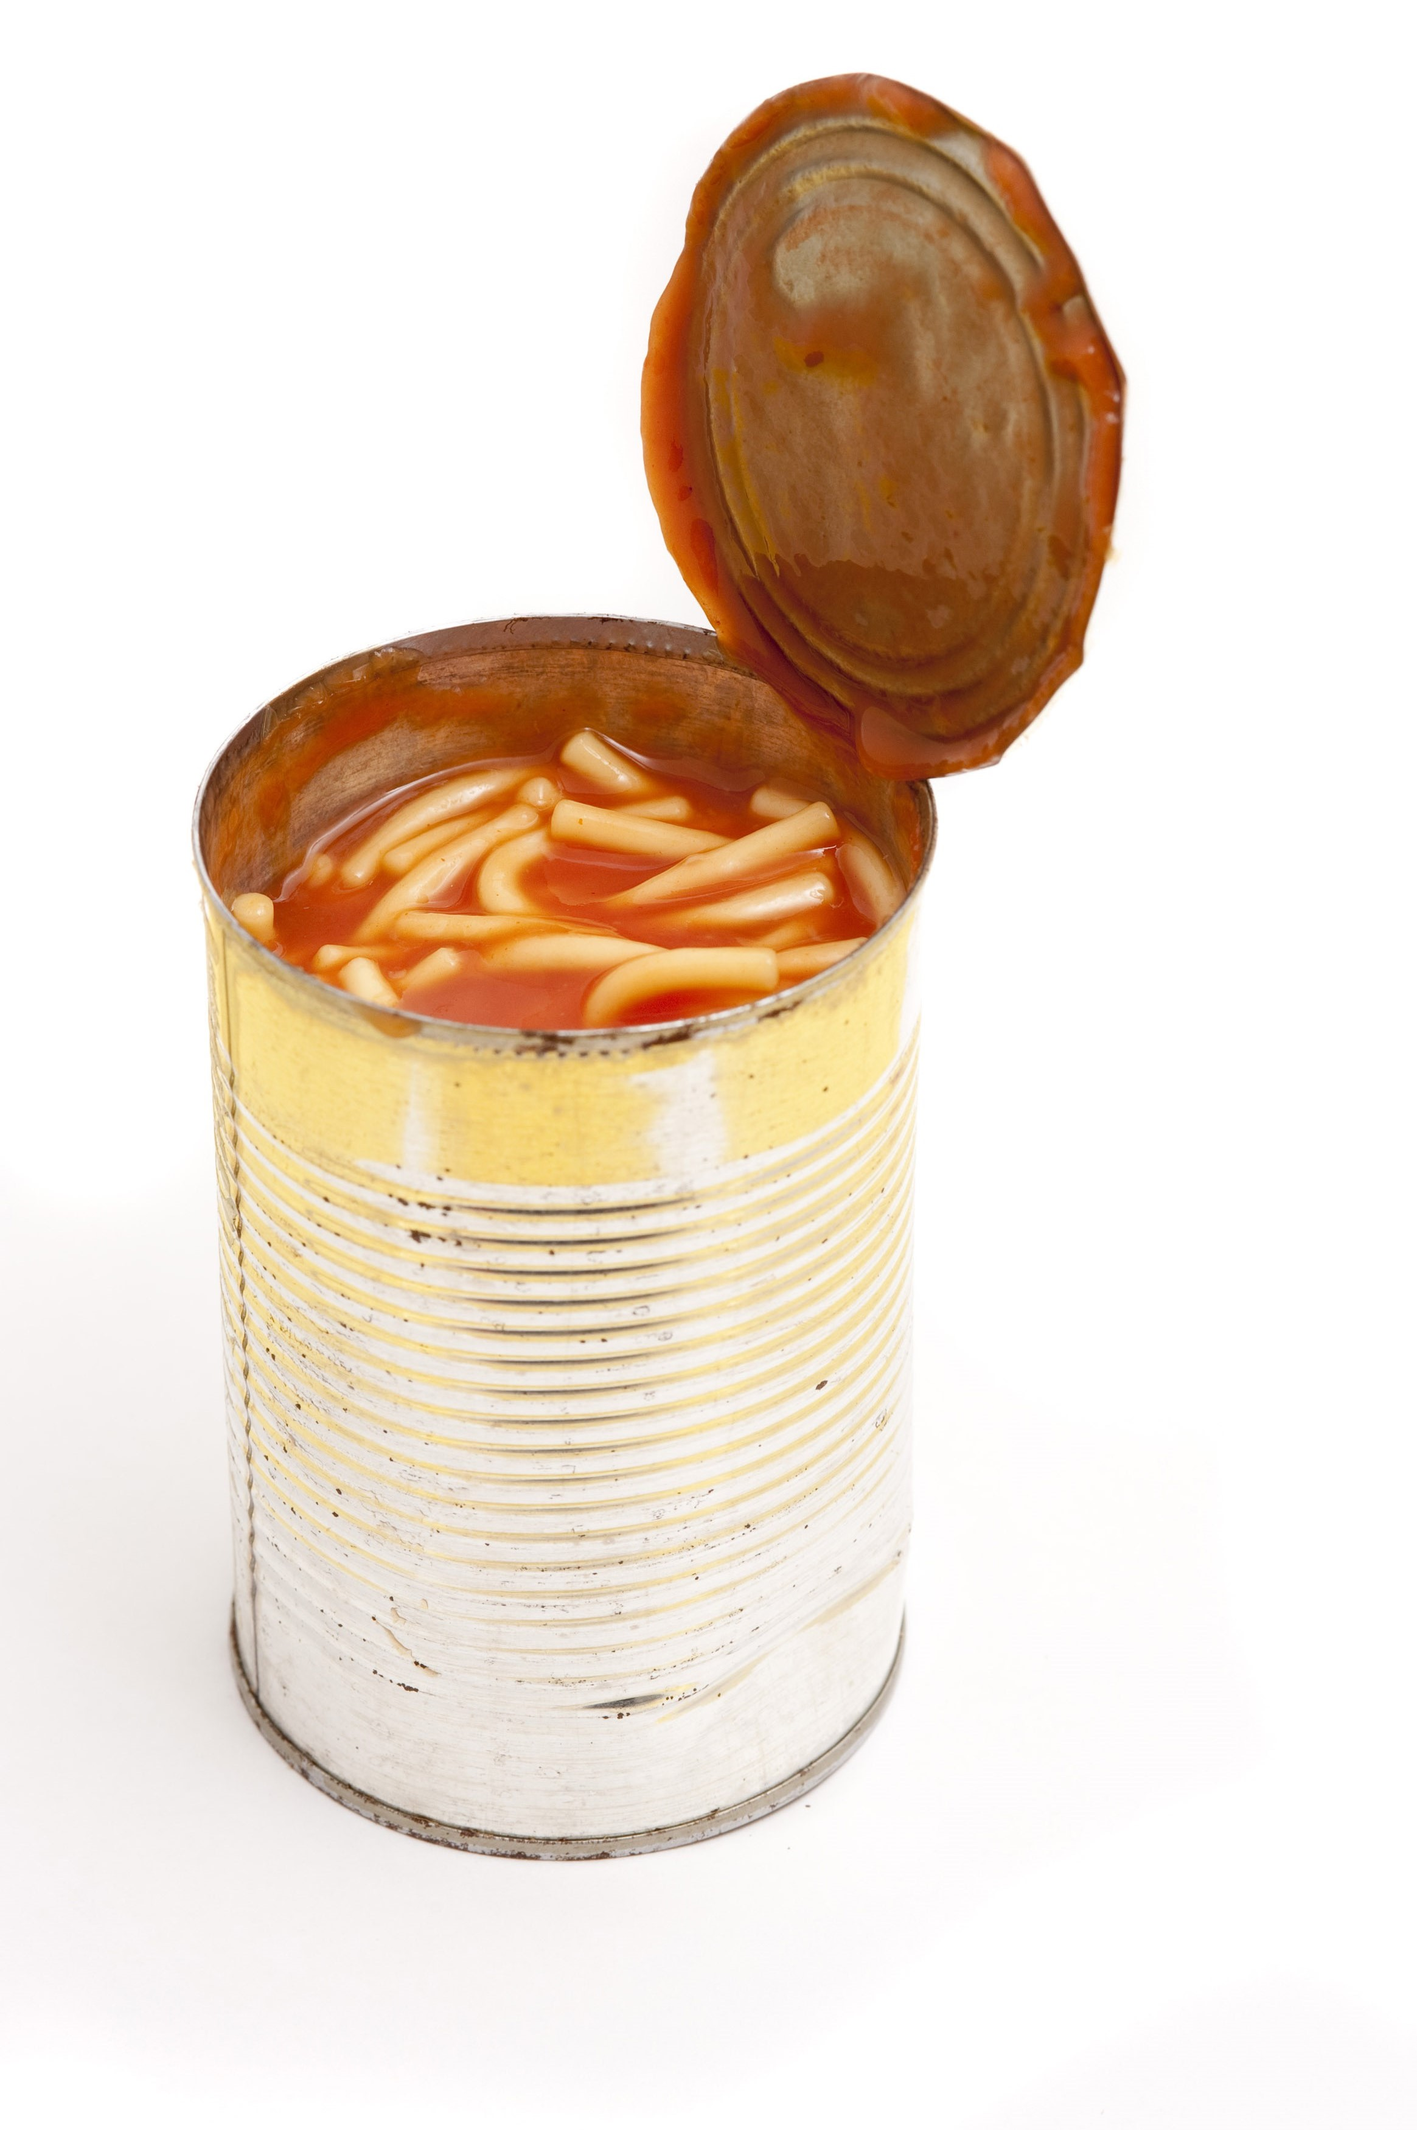
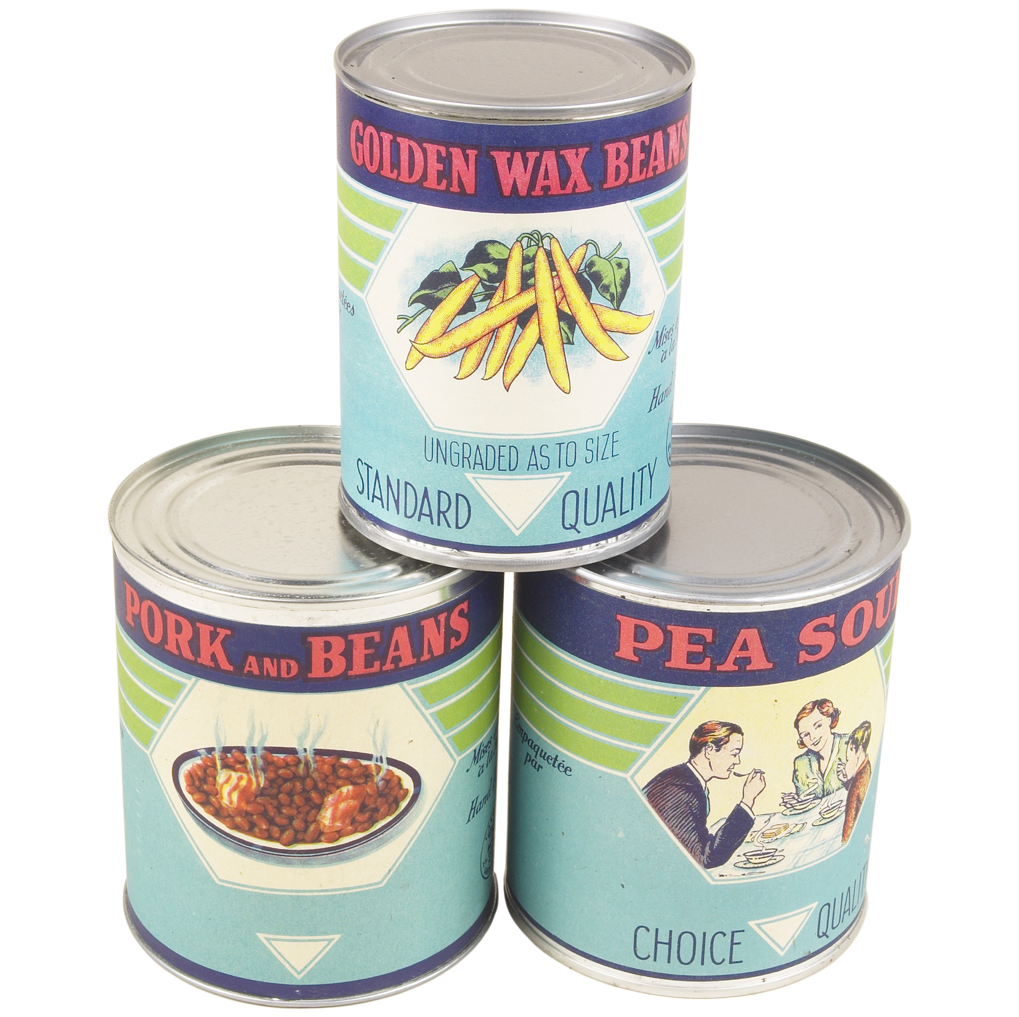
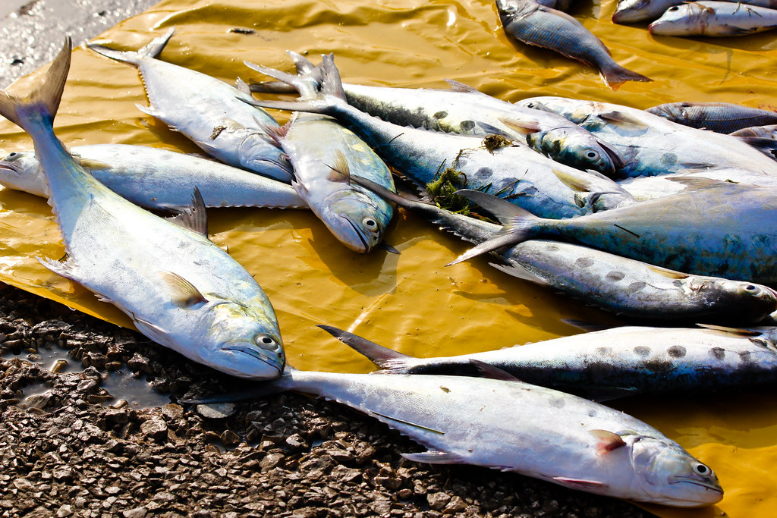
TYPES OF FOOD-BORNE-ILLNESSES
Botulisum (bot·u·li·num)
Clostridium Botulinum can develop from canned
(especially home canned) low acid food and in some cases
can occur from eating raw or parboiled (undercooked) meats from
marine mammals. Symptoms can include double vision, nausea,
vomiting, fatigue, dizziness, headache and dryness in the throat and
nose and in extreme cases, respiratory failure.

Slide 11
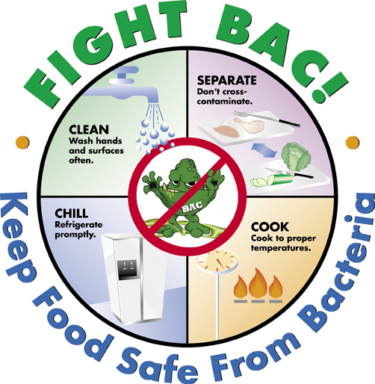
Preventing Food-Borne Illness
Notes:
Adapted from OFSLC Food Safety Resources

Slide 12

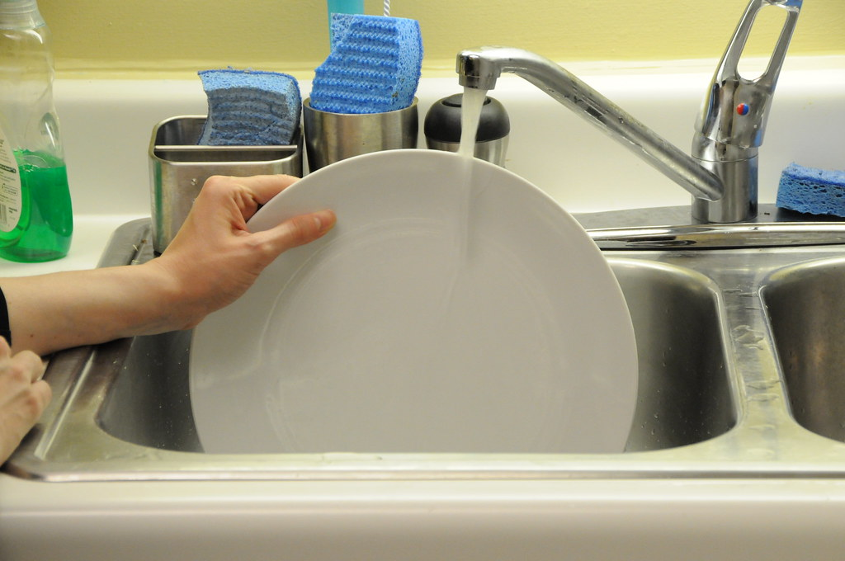

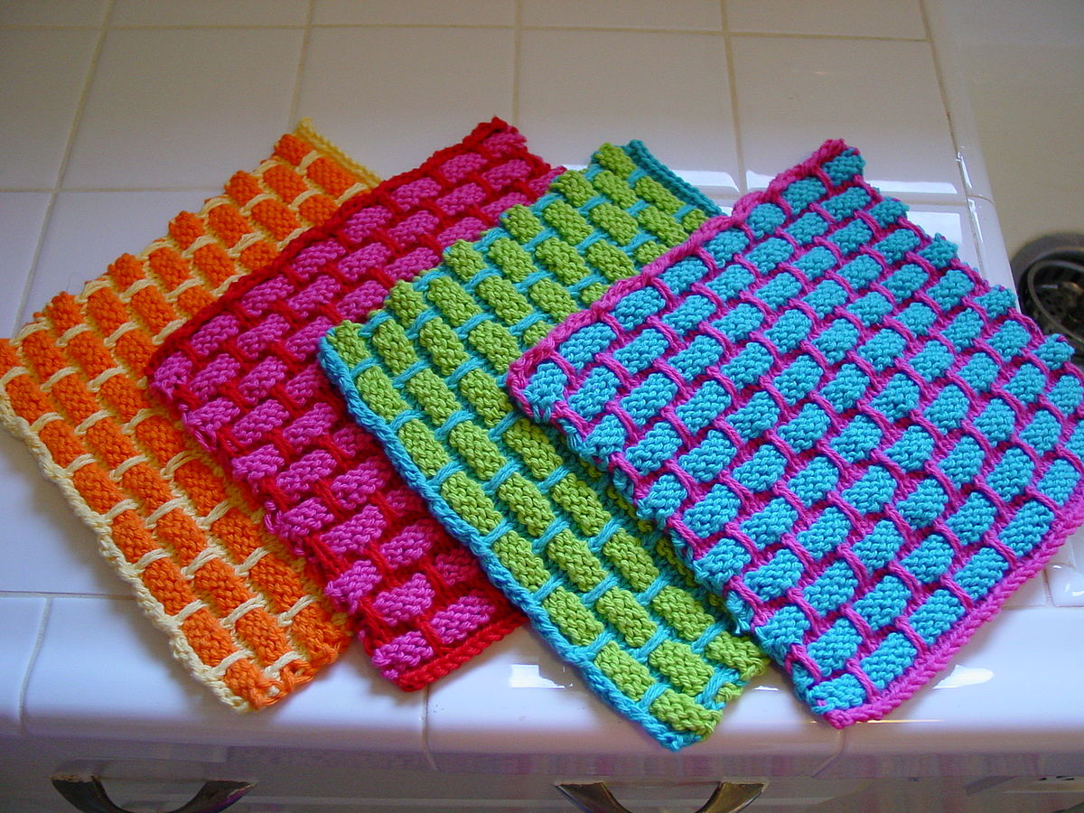
Preventing Food-Borne Illness
Step 1: CLEAN
Wash hands with hot soapy water before handling food for at least 20 seconds).
Wash all items with hot soapy water and immediately after coming in contact with raw meats, seafood and eggs.
Use plastic and non-porous cutting boards (not wood).
Wash dish cloths often in the hot cycle and follow proper dishwashing techniques.
This Photo by Unknown Author is licensed under CC BY-SA

Slide 13
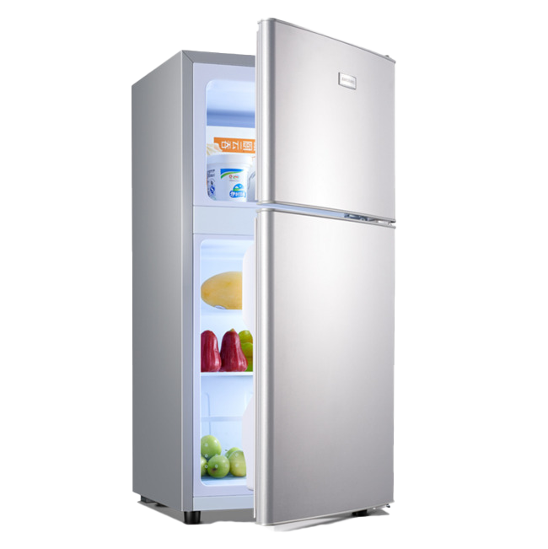


Preventing Food-Borne Illness
Step 2: SEPERATE
Avoid Cross-contamination = spreading bacteria from one food product to another.
Separate raw meat and seafood from other foods in your grocery cart & refrigerator.
Place raw meats and seafood on bottom shelf of refrigerator.
Use different cutting board for raw meats and seafood.
NEVER place cooked food on a plate which previously held raw meat, seafood or eggs.
]

Slide 14
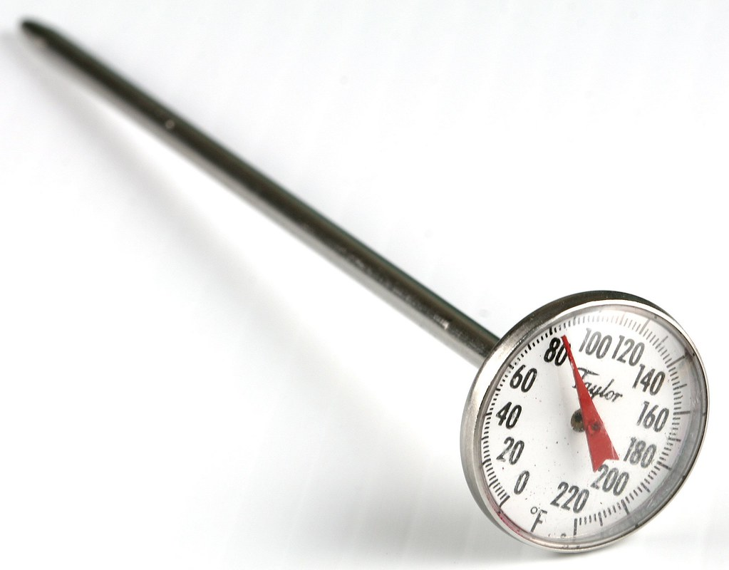
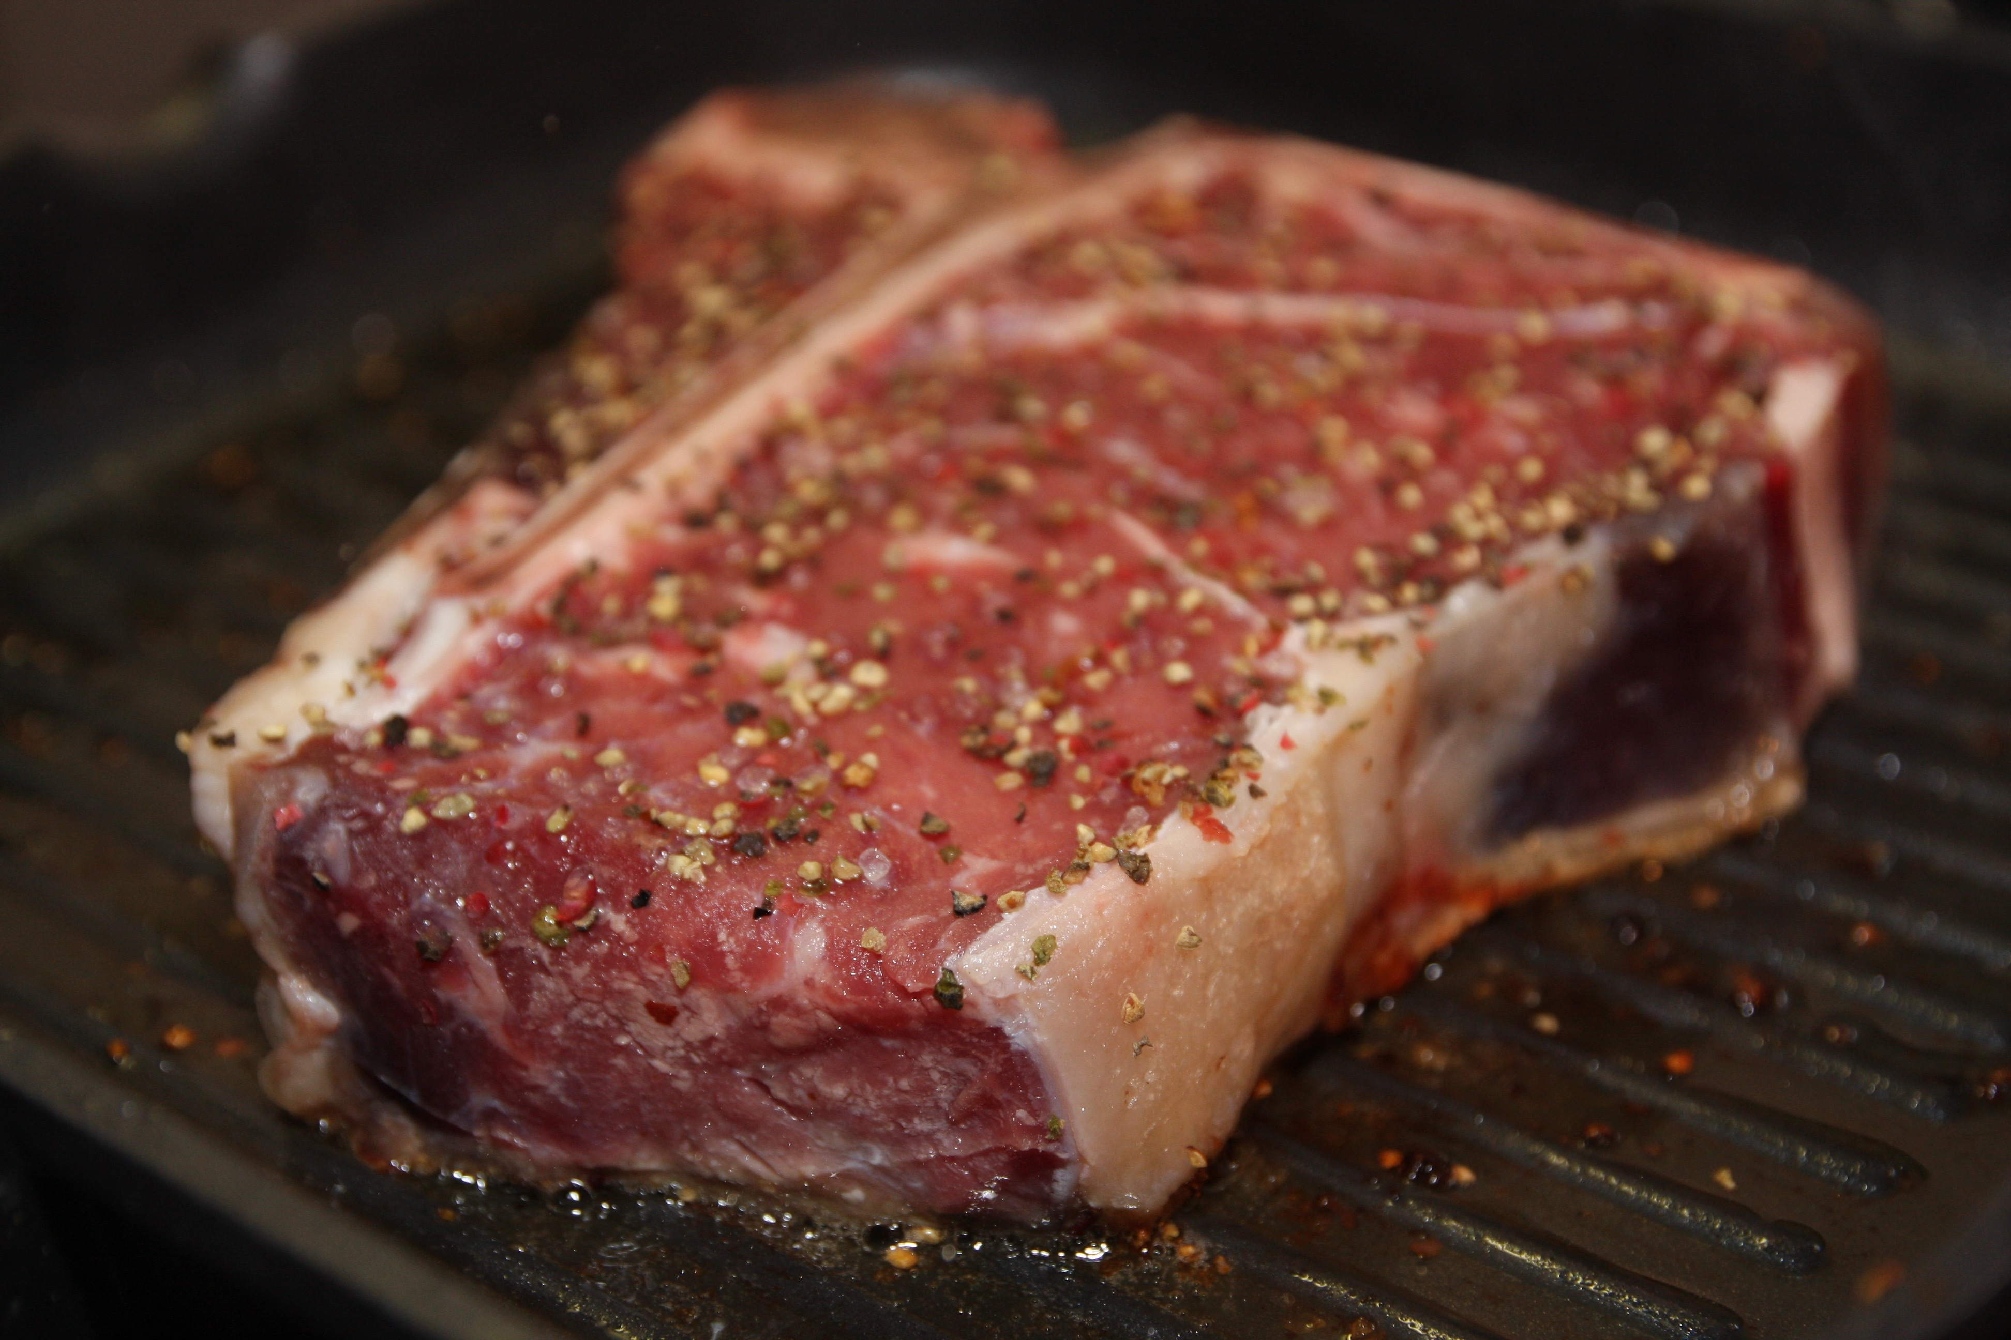
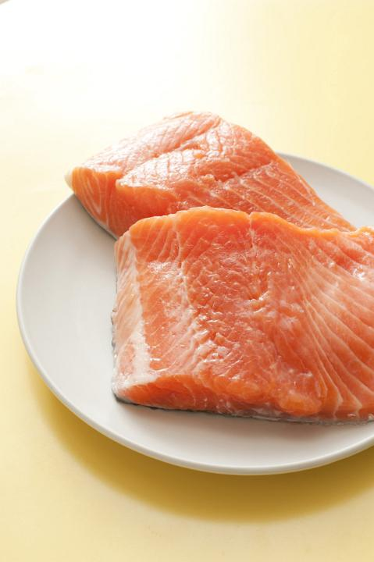
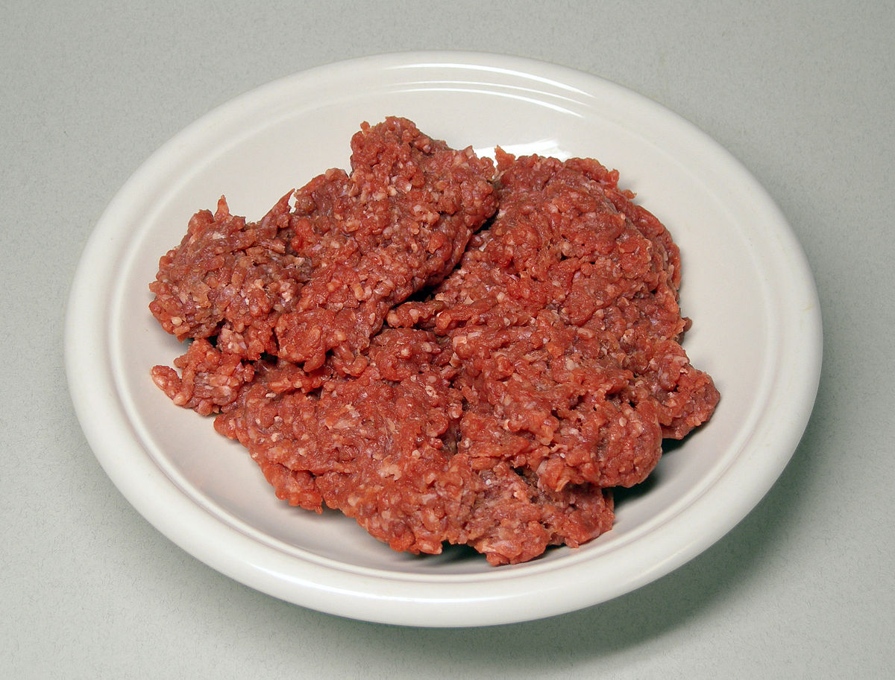
Preventing Food-Borne Illness
Step 3: COOK (Temperature)
Raw foods need to be cooked to different internal temperatures – use a food thermometer
to check.
Steak and Poultry:180°F/82ºC
Roast beef:145°F/62ºC
Ground beef:160°F/71ºC Fish:145°F/62ºC

Slide 15



Preventing Food-Borne Illness
Step 4: CHILL (Temperature)
Refrigerate or freeze food that can go bad (perishables), prepared food and leftovers
within 2 hours.
Never defrost food at room temperature
  Thaw food in the refrigerator, under cold running water or in the microwave.
  Marinate foods in the refrigerator.

Slide 16

Video
Public Health Agency of Canada:
Something you ate? - Episode 4: Protecting yourself
Notes:
Teacher’s notes: Asking for personal anecdotes and/or experiences may facilitate understanding here. Good opportunity to get ELLs speaking and sharing cultural connections.
Video link: https://youtu.be/0h01ANHYfm8

Slide 17
Vocabulary Chart
Take some time to add new words
to your vocabulary sheet. In your groups, complete the Food-Borne Illness chart.
(See examples on next slide)

Slide 18
Vocabulary Chart
Word | Definition | Example: (Use this word in a sentence)
bacteria | any one of a group of very small living things or organisms that often cause disease | Keep food in the refrigerator to prevent bacteria from growing on it.

Slide 19
Food-Borne Illness Chart
Food-Borne Illness | Definition | Example: How can you prevent this food-borne Illness ? (refer back to ppt.)
Salmonella | Symptoms include stomach pain, fever, diarrhea and vomiting. It usually takes about 12-48 hours for the illness to develop. Symptoms can be much more severe in the young and elderly. Main sources are undercooked meat and poultry, untreated milk and raw or undercooked eggs. This organism is the 2nd most common form of food poisoning. | Always cook raw meats to the correct temperature.

Slide 20
Exit Question/Reflection
In your notes answer the following
questions:
1. What are four the FightBac steps to keeping
food safe from bacteria?
Think about when you prepare food at home –
Describe the steps you took to keep your food safe
from bacteria.
Notes:
Teacher’s notes: be mindful of sensitivities, respect privacy, and provide alternative questions where applicable.

Slide 21

Questions?

